Slide 1

Customer Experience Strategy
CXS Release 2

Slide 2
CXS - R2 – July 2026
Customer Experience Strategy
First Touch Resolution Customer Care Enhancements
01
Transforming employee benefit and absence experiences, where empathy meets innovation.
CXS Release 2 is the second milestone of technology releases, process automation and human capital investments to deliver industry leading service.
Claim Summarization through AI Automation
02
Established Customer Experience Platform (cXp)
03

Slide 3

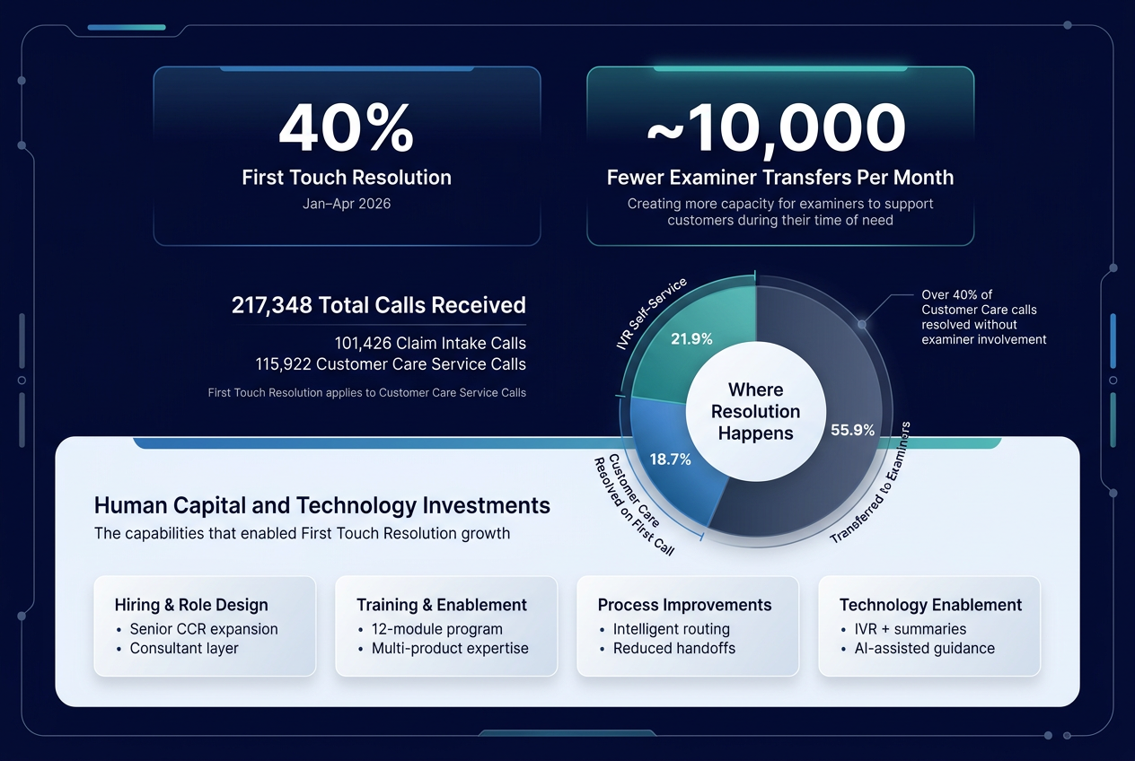
First Touch Resolution Customer Care Enhancements
Since Jan 2026, our First Touch Resolution journey reflects a deliberate shift from routing inquiries to resolving them at the first point of contact. It is focused on empowering teams to resolve customer needs immediately.
R2 Deployments:
Dedicated CCR layer between intake and examiner
The model was deployed for all clients.
Customer Care model expansion
Moved from 15 to 60 senior customer care consultants

Slide 4
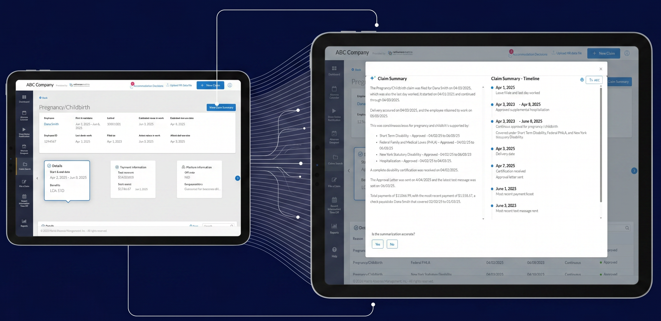
Claim Summarization through AI Automation
Provides a clear, real‑time snapshot of a claim, so employees, employers and our service teams can immediately understand where an employee is in their leave journey.
R2 Deployments:
Claim Summary View
Consolidated snapshot of each claim deployed for all clients.
AI-Assisted Claim Context and Guidance
Surfaces relevant claim information and likely questions for our Claim Care team.

Slide 5
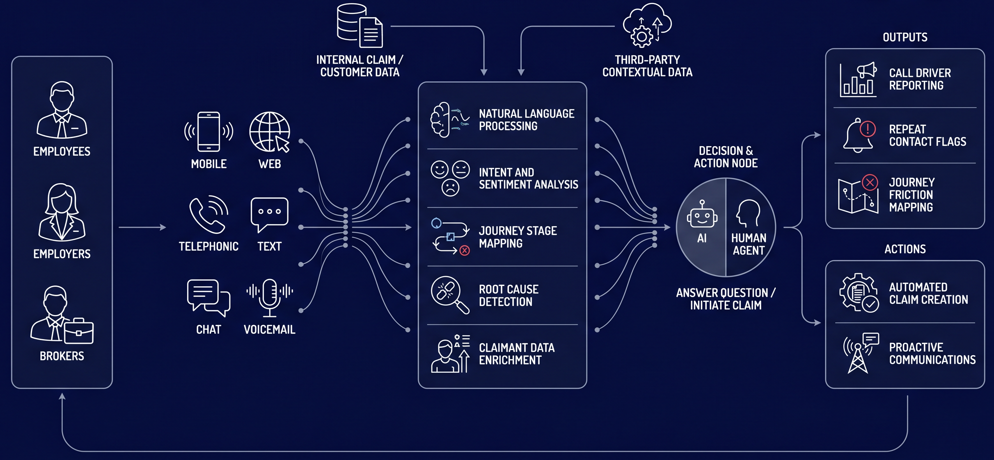
Established Customer Experience Platform (cXp)
cXp – The platform seeks to connect every interaction, insight, and action, empowering our teams to anticipate needs, resolve issues on the first touch and deliver a simpler, more intuitive journey.
CURENTLY UNDERWAY
Agentic Agent: Self Service
Humanistic conversation with employee, enriched by claim data to provide common self-service requests. The result is faster resolutions and freeing up human agents to focus on complex, high-value interactions.
Analytics Engine: Top inquiries
Leveraging AI to analyze 7 months of claimant emails, voicemails and call recordings. This will identify the most common inquiries, summarize trends, and highlight opportunities to improve customer service.

Slide 6
